Slide 1
Portable Mini Refrigerator
Presentation by
OMKAR GUJJA ( 71 )
SHASHIKANT SADHAPHULE (62)
ADVAIT BHOSLE (72)
Under the Guidance of
Prof. Raghuvendra S. Upadhyay
Department of Mechatronics Engineering
TERNA ENGINEERING COLLEGE NERUL
University of Mumbai

Slide 2
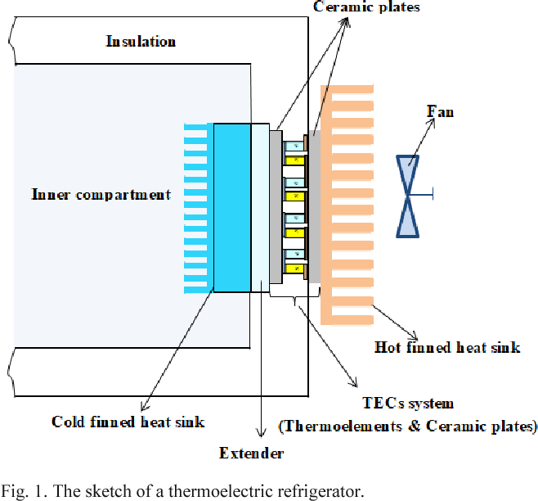
Problem Definition
Building refrigerator based on thermoelectric cooling.
Making use of Peltier modules devices for cooling.
Making a portable model.

Slide 3
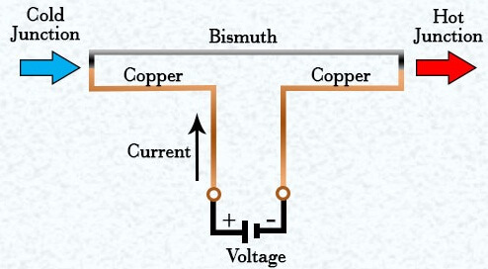
Introduction
What is Peltier effect ?
The effect creates a temperature difference by transferring heat between two electrical junctions. When the current flows through the junctions of the two conductors, heat is removed at one junction and cooling occurs.

Slide 4
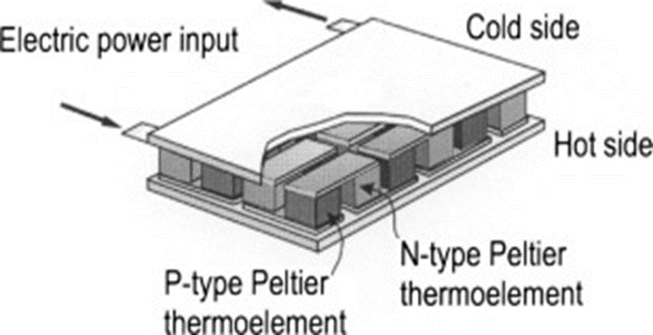
Working
Electrons move freely in copper conductor but not so freely in semi conductor.
As the electrons leave the copper and enter hot side of p-type they must fill a hole in order to move through the p-type. When electrons fill a hole they drop down to a lower energy level and release heat in the process.
Then as electrons move from the p type to copper conductor on the cold side the electrons are bumped back to higher energy levels and absorb heat in the process.

Slide 5
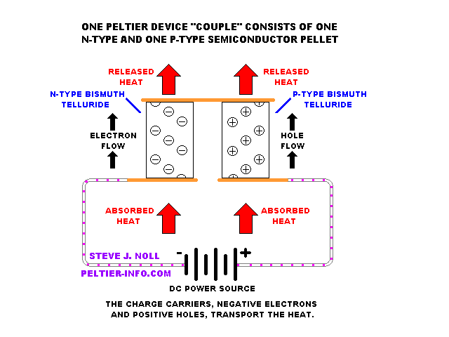

Slide 6
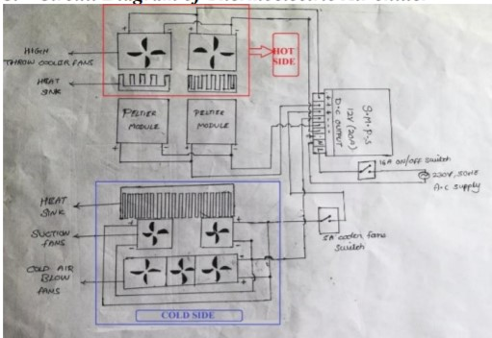
Circuit Diagram

Slide 7
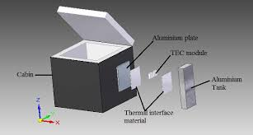
Exploded View

Slide 8
Project Implementation/Methodology
Parts to be used
Peltier modules - 12706 - 12 volt 6 amp max temp 138 C cooling temp 0C
Dc cooling fan
Supporting Frame
Digital Thermometer with LCD display
SMPS
Aluminum Heat sink
Screws & Joints

Slide 9
Advantages
Compact size make them useful for applications where size or weight is constraint.
Able to operate in any orientation.
Ability to alternate between heating and cooling.
No moving parts makes them very reliable.

Slide 10
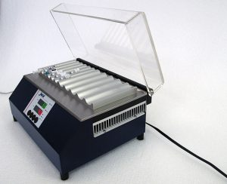
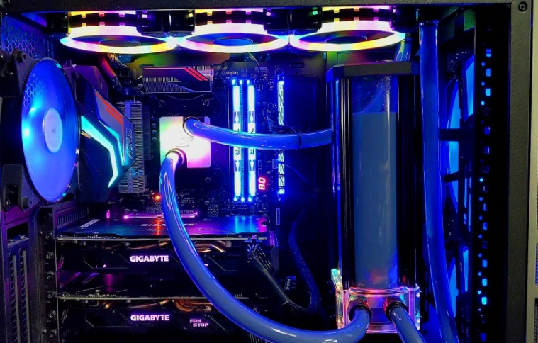
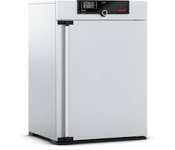
Applications
Applications
Cooling
Electronic enclosures
Cooling electronic components
Cooling laboratory instruments
Refrigerators
Temperature control in missiles and space system

Slide 11
(Gantt chart)Schedule of project work
(Gantt chart)Schedule of project work
19 march – 23 march | 23 march - 31 march | 1 April– 7 April | 8 April– 15 April | 16 April – 23 April
Purchasing
Making Outer Body
Assembling the Electronics
Assembling the Electronic part with Outer Body
Testing & Troubleshooting
Report

Slide 12
References
Taylor, R.A.; Solbrekken, G.L. (2008). "Comprehensive system-level optimization of thermoelectric devices for electronic cooling applications". IEEE Transactions on Components and Packaging Technologies.
Zhao, Donglian g (May 2014). "A review of thermoelectric cooling: Materials, modeling and applications". Applied Thermal Engineering.
Poudel, Bed (May 2008). "High-Thermoelectric Performance of Nanostructured Bismuth Antimony Telluride Bulk Alloys". Science.
Brown, D. R.; N. Fernandez; J. A. Dirks; T. B. Stout (March 2010). "The Prospects of Alternatives to Vapor Compression Technology for Space Cooling and Food Refrigeration Applications" (PDF). Pacific Northwest National Laboratory (PNL). U.S. Department of Energy. Retrieved 16 March 2013.
https://espressomilkcooler.com/thermoelectric-peltier-cooler-module-selection/

